Slide 1


Ain’t no party like a crypto party, Berktern skill share

Slide 2


Whose Security?
National security? Infrastructure security? Human security?
Security = being set free from structural constraints (?)

Slide 3


Common Threats
By the State: police & intelligence agency surveillance

Slide 4
Common Threats
By the State: police & intelligence agency surveillance, censorship

Slide 5
Common Threats
By the State: police & intelligence agency surveillance, censorship
By companies: direct surveillance, sale of data to 3rd parties, social network mapping, data mining

Slide 6
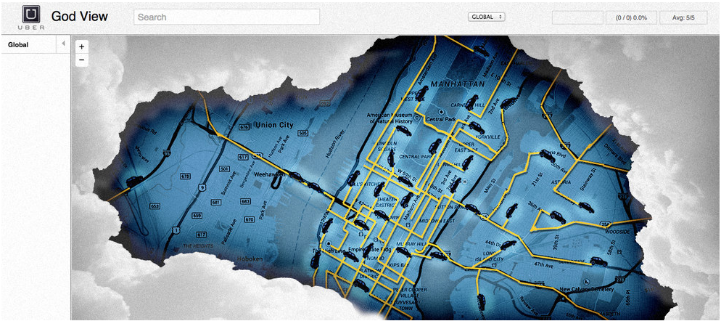
Common Threats
By the State: police & intelligence agency surveillance, censorship
By companies: direct surveillance, sale of data to 3rd parties, social network mapping, data mining

Slide 7
FACEBOOK CONFIDENTIAL AND PROPRIETARY
3. Profiles:
4. Data Requested:
{Please add an “x”}
□ Recent IP Address Login
□ Specific log including date and time zone
□ Status Update History
□ Wall Postings
□ Future and Past Events
□ Shared Files
□ Private Messages
LAW ENFORCEMENT USE ONLY page 9 of 9
Common Threats
Profile Name/Group
ID Number
By the State: police & intelligence agency surveillance, censorship
By companies: direct surveillance, sale of data to 3rd parties, social network mapping, data mining

Slide 8

Digital security manages these threats
If you’re interesting enough, you will
likely be targeted
If you’re not…? Security is hard to get right, so be proactive

Slide 9

WHAT IS DIGITAL SECURITY?

Slide 10

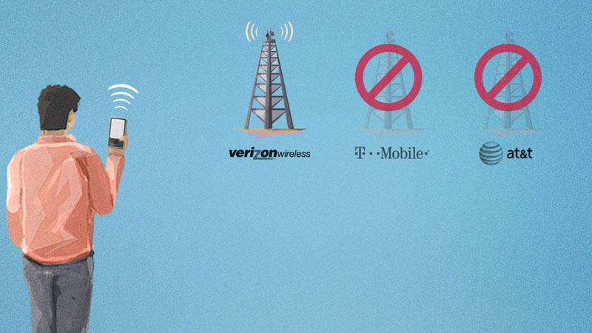

THE FOUR LEVELS OF SECURITY
Network Security
Message Security
Device Security
Human Security

Slide 11
Network Security
What is it?
→ Blocking sites that track you and encrypting your internet traffic.
When to use it?
→ To protect against behavioural tracking, account hijacking, censorship, and surveillance
How?
→Block outgoing or incoming connections (ad blockers, uBlock Origin, Privacy Badger)
Tunnel traffic (Virtual Private Networks, Tor)

Slide 12
Message Security
What is it?
Ways to encrypt individual messages you send and receive
When to use it?
If you want to ensure the confidentiality of a particular message while stored and transmitted.
How?
Encrypt the message end-to end (PGP for email, Signal for text messaging, OTR for instant messaging)

Slide 13
Message Security
Some Caveats:
Remember that encrypting your messages:
  ▸ does not hide your identity
  ▸ does not hide the subject line
If your device or that of the recipient is compromised, your conversation is also likely compromised.

Slide 14
Device Security
What is it?
Steps to make your computer or phone less vulnerable to attack.
When to use it?
Useful whenever your device might physically fall into the hands of an attacker.
How?
Full disk encryption (for your phone and computer)
Regular software updates
Minimum applications installed
Strong password(s)

Slide 15
Human Security
What is it?
Simple changes you can make to your behaviour.
When to use it?
Helps prevent human error from being the weak link in any security system.
How?
Strategic choices about where and how you access the Internet (e.g., avoiding shared computers, public/free wifi)
Be mindful of social engineering
Strong, unique passwords & management tools

Slide 16
Human Security

Slide 17
TOR

Slide 20
Public vs. Private Keys

Slide 21
Secure Messaging
 | Whatsapp | Telegram | Signal
Source code | closed source | open source | open source
Api | none | various | library
Encription protocol | state of the art | self made | state of the art
Contact list location | cloud | cloud | cloud, encrypted
Forward Secrecy | yes | yes | yes
Database | phone storage | cloud | phone storage
Backup capability | Icloud or Gcloud | builtin | none
Revenue | ads (Facebook) | donation based | donation based
Federation | no | no | no
Alternative download location | website | F-Droid | none
Uses third party services | no | no | Google Cloud Messaging
Servers location | US | Russia | US
Tied to mobile number | yes | yes, but nickname available | yes
Desktop client | no | yes | no

Slide 23
“Diventiamo individui attraverso la scoperta che possiamo nascondere qualcosa negli altri.”
“We develop our individuality by revealing little pieces of ourselves to others.”
Emilio Mordini

Slide 24
Thanks! Questions?

Slide 25
More Resources
RiseUp.Net, Communications Security https://help.riseup.net/en/security
EFF, Surveillance Self Defense https://ssd.eff.org/
Equalit.ie, Digital Security Lessons https://learn.equalit.ie/wiki/Online_Learning
Tactical Tech, Security in a Box https://securityinabox.org/en
Freedom of the Press Foundation, Encryption Works https://github.com/freedomofpress/encryptionworks/blob/master/encryption_works.md
Tactical Tech, Gender and Security https://gendersec.tacticaltech.org/wiki/index.php/Main_Page
Credit to fixthedmca.org for graphics

